Slide 1


An Introduction to Data Assimilation
Romain Chassagne (BRGM)
Principal Researcher & Digital Twin Coordinator
4th NuTS Workshop, Tuesday 26 May 2026, Strasbourg,

Slide 2
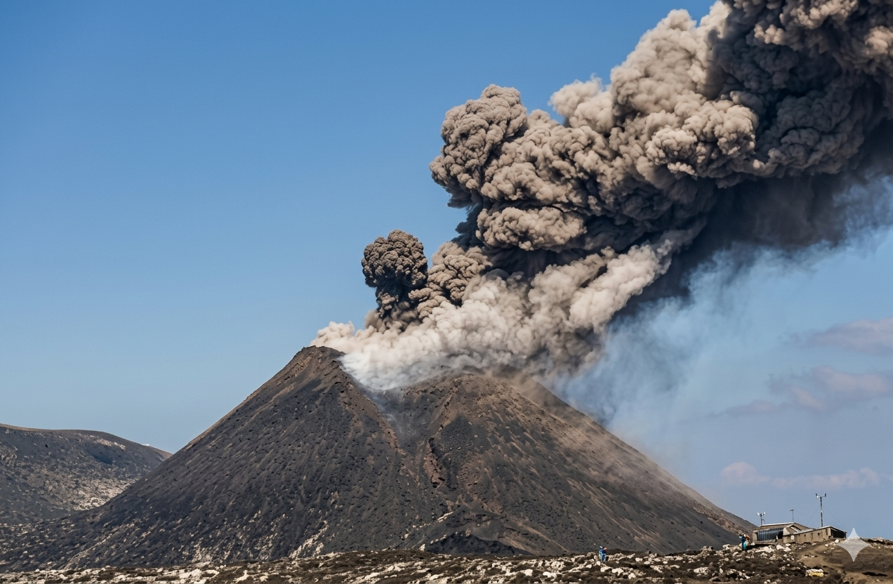

Slide 3
1971 Eruption of Mount Etna

Slide 4
What happened: A flank eruption opened on the eastern side, destroying villages and infrastructure.
1971 Eruption of Mount Etna
Forecasting: None. Authorities reacted after the eruption began.
Consequences: Late evacuations, significant damage.

Slide 5
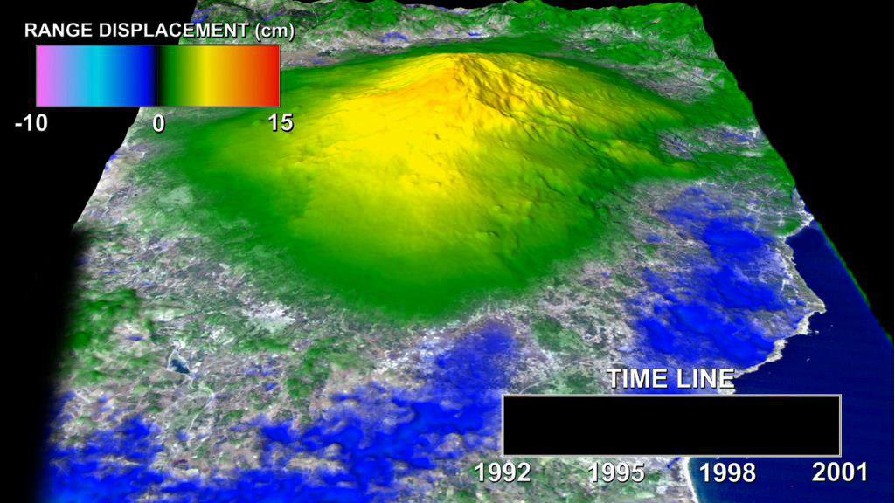
2001 status of Mount Etna
Ground deformation of Mount Etna (1992–2001) – InSAR observations
Red/orange: Uplift (magma inflation) | Blue: Subsidence (deflation)
Source: NASA JPL (Lundgren et al., 2004)..

Slide 6
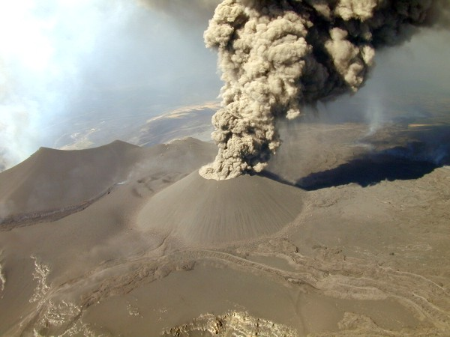
What happened: Lateral eruption with lava fountains and flows toward the south.
2001 Eruption of Mount Etna
Forecasting: Scientists knew an eruption was likely (due to seismicity and deformation), but could not specify where or when,
Consequences: Broad preventive evacuations (sometimes unnecessary), high economic costs.

Slide 7
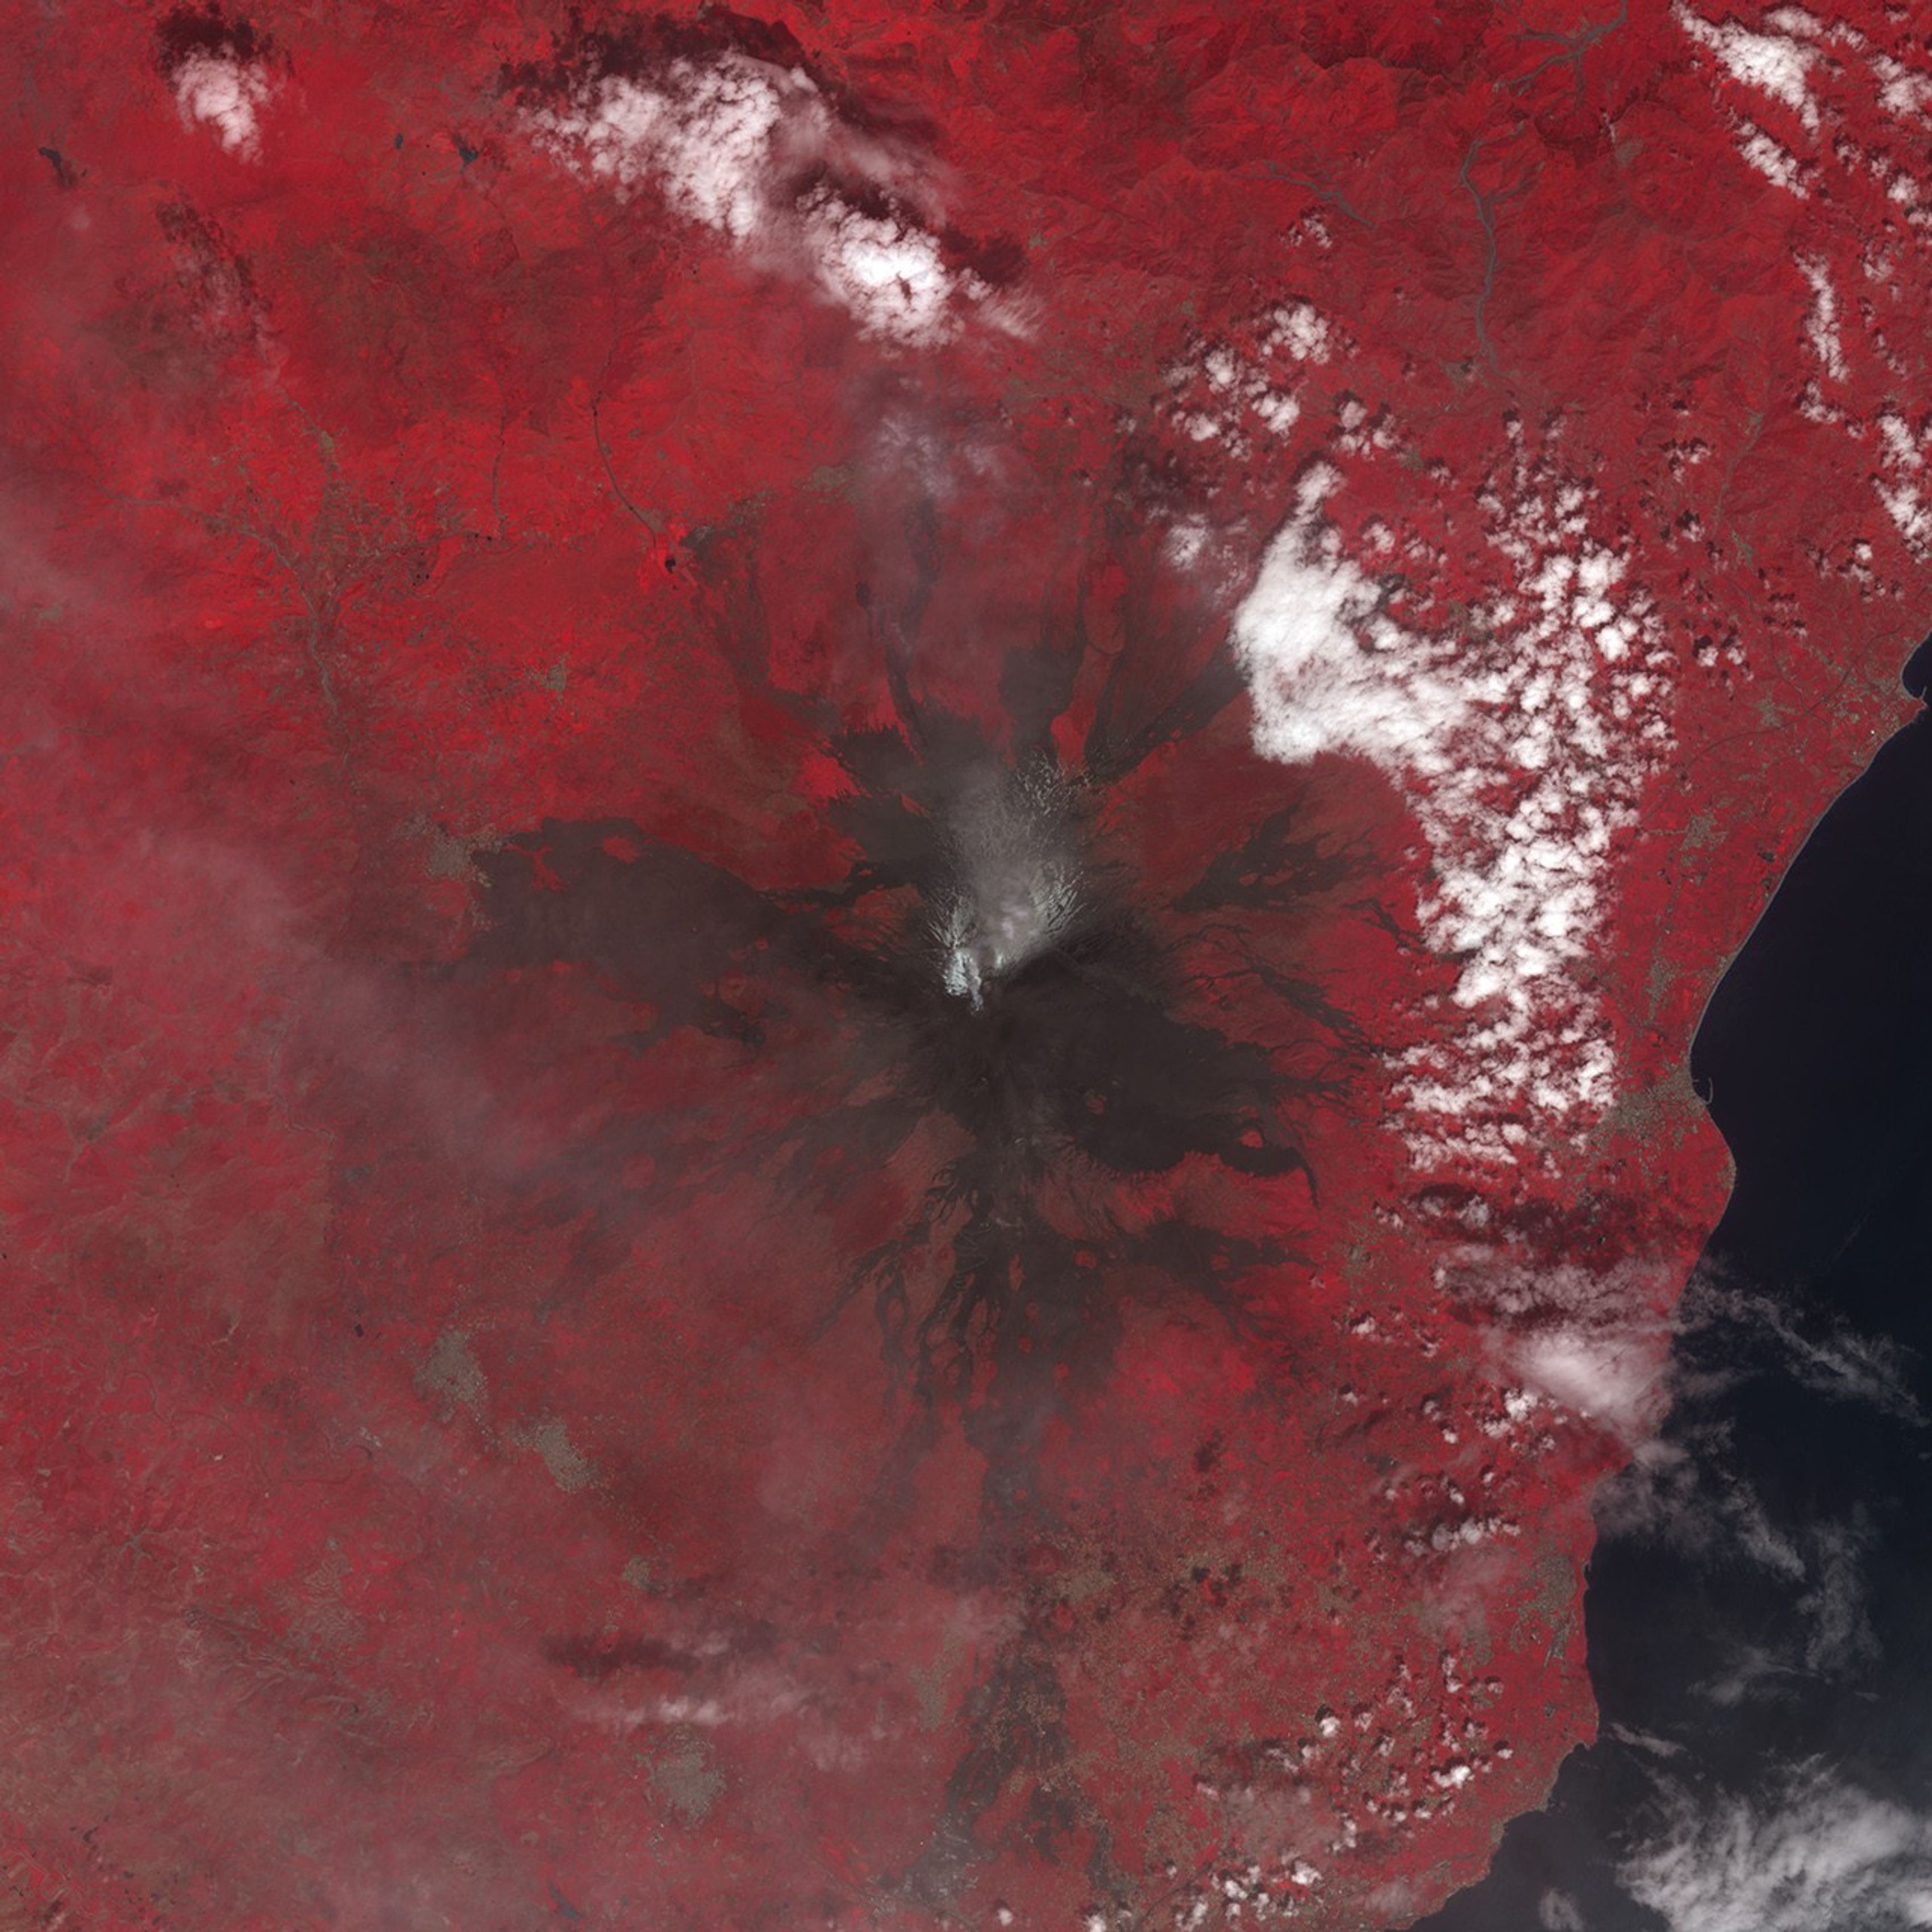
What happened: Magma intrusion caused a magnitude 4.9 earthquake and a lateral eruption.
2018 Eruption of Mount Etna
Forecasting: GPS, InSAR, and seismicity located the moving magma and predicted the opening of fissures on the eastern flank.
Consequences: No casualties, Evacuations limited to high-risk areas, reducing damage.
NASA Earth Observatory

Slide 8


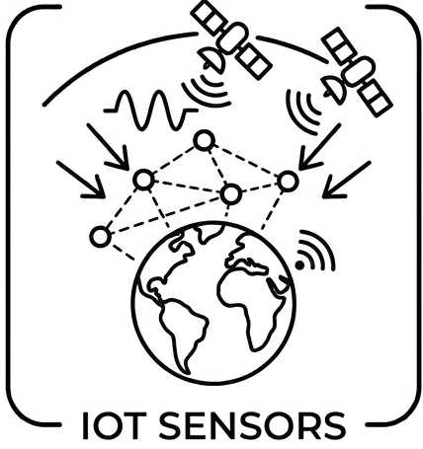
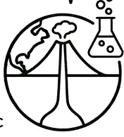
Mount Etna case
1971
2001
2018
Significant damage, late evacuations
High economic costs
Targeted evacuations
Empirical
Based on precursors
Manual
analyzed in parallel
Data assimilation
Ensemble methods
INGV / Bato et al,,2017 / De Novellis et al. (2019) / Beccaro et al,, 2023

Slide 9
Mount Etna case
Data assimilation level
1971
2001
2018
Significant damage, late evacuations
High economic costs
Targeted evacuations
Empirical
Based on precursors
Manual
analyzed in parallel
Data assimilation
Ensemble methods
INGV / Bato et al,,2017 / De Novellis et al. (2019) / Beccaro et al,, 2023

Slide 10
Mount Etna case
Data assimilation level
1971
2001
2018
No numerical model
Static modelling
Updated dynamic model(s)
Significant damage, late evacuations
High economic costs
Targeted evacuations
Empirical
Based on precursors
Manual
analyzed in parallel
Data assimilation
Ensemble methods
INGV / Bato et al,,2017 / De Novellis et al. (2019) / Beccaro et al,, 2023

Slide 11
Back in history
Data assimilation
Today
Mount Etna
1723-1762
2026

Slide 12
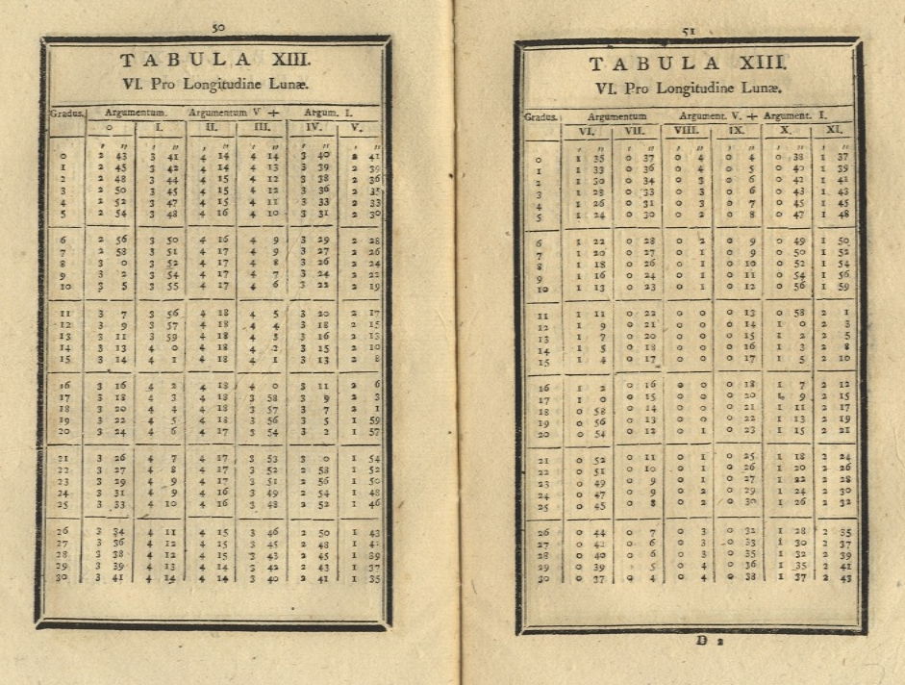
Back in history
Data assimilation
Today
Mount Etna
1723-1762
2026
Stephen Stigler, The History of Statistics: The Measurement of Uncertainty before 1900
Johann Tobias Mayer and the Method of Averages:
Model = The physical equations of the Moon's motion,
Data = The 27 imperfect observations from his telescope.
Assimilation = His averaging method. It served as a bridge to force the theoretical model to "adjust" and to "assimilate" the noise of reality, becoming extremely precise.

Slide 13
Back in history
Data assimilation
Today
1752-1834 (Legendre)
1777-1855 (Gauss)
Mount Etna
1723-1762
2026
Stephen Stigler, The History of Statistics: The Measurement of Uncertainty before 1900
Johann Tobias Mayer and the Method of Averages:
Model = The physical equations of the Moon's motion,
Data = The 27 imperfect observations from his telescope.
Assimilation = His averaging method. It served as a bridge to force the theoretical model to "adjust" and to "assimilate" the noise of reality, becoming extremely precise.
Formalised 50 years later by Gauss and Legendre into least square method

Slide 14
Back in history
Data assimilation
Today
1960
(Kalman filter)
1752-1834 (Legendre)
1777-1855 (Gauss)
Mount Etna
1723-1762
2026
Stephen Stigler, The History of Statistics: The Measurement of Uncertainty before 1900
The Kalman Filter:
He designed a mathematical algorithm to estimate the true state of a changing system from a stream of noisy measurements
Finding the “perfect” balance between an imperfect physical model and noisy data.

Slide 15
Back in history
1980-1990 (Variational methods)
Data assimilation
Today
1960
(Kalman filter)
1752-1834 (Legendre)
1777-1855 (Gauss)
Mount Etna
1723-1762
2026
Stephen Stigler, The History of Statistics: The Measurement of Uncertainty before 1900
Variational methods:
Traditional methods couldn't handle this explosion of data. This led to the development of 3D-Var and 4D-Var (Variational techniques) by weather centers like the ECMWF (European Centre for Medium-Range Weather Forecasts).

Slide 16
Back in history
1980-1990 (Variational methods)
Data assimilation
Today
1960
(Kalman filter)
1752-1834 (Legendre)
1777-1855 (Gauss)
Mount Etna
1723-1762
2026
Stephen Stigler, The History of Statistics: The Measurement of Uncertainty before 1900
Ensemble methods, in details in the following

Slide 17
Data assimilation, an example
Data assimilation, a brief history
What Data Assimilation stands for?

Slide 18
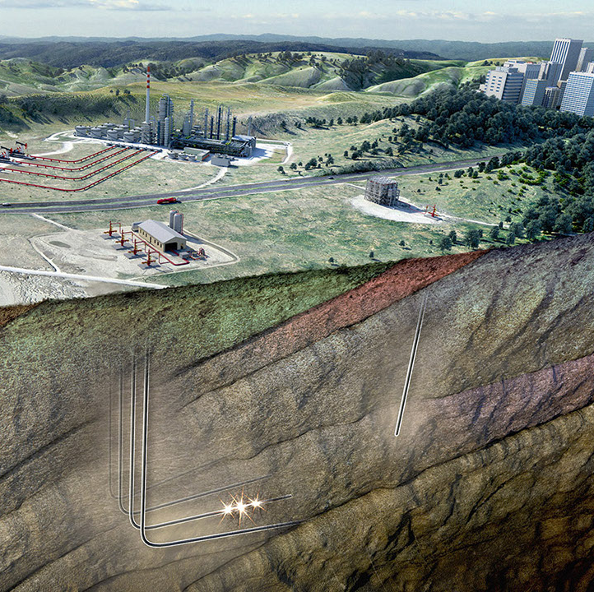
Domain of application
  Volcanology
  Earthquakes (seismicity and risks)
  Climate, weather forecasting
  Low-carbon energy (e.g. geothermal, hydrogen)
  Water resource management
  CO₂ sequestration
  Underground waste disposal
  Critical minerals (e.g. lithium)
  Geodynamics and Tectonics
To date, the integration of multi-scale, multi-physics, and multi-source observations and modelling remains a significant and unresolved challenge.
No established and recognized guidelines or consensus to follow.

Slide 19
Data Assimilation, What for?
DA is for forecasting, prediction and what-if scenario. It is to assist understanding of physical processes and assist a decision making.
What is the volume, depth, and pressure rate increase of the hidden magma chamber?
How much tectonic stress has accumulated along a specific fault?
What was the historical trajectory of mantle convection cells over the past 100 million year?
How will a heat source degrade over time?
What is the volume in place?
What are the spatio-temporal changes of a contaminant plume?
How will a CO2 plume migrate?
What is the risk of induced seismicity and the zone impacted?
What are the fluid flow paths?
What is the production rate?
What is the sustainability of the resource?
What is the wellbore integrity and corrosion rate?
Where should wells be placed for optimal production?
What production interference could I expect in my zone located next to a potential new producing zone?

Slide 20
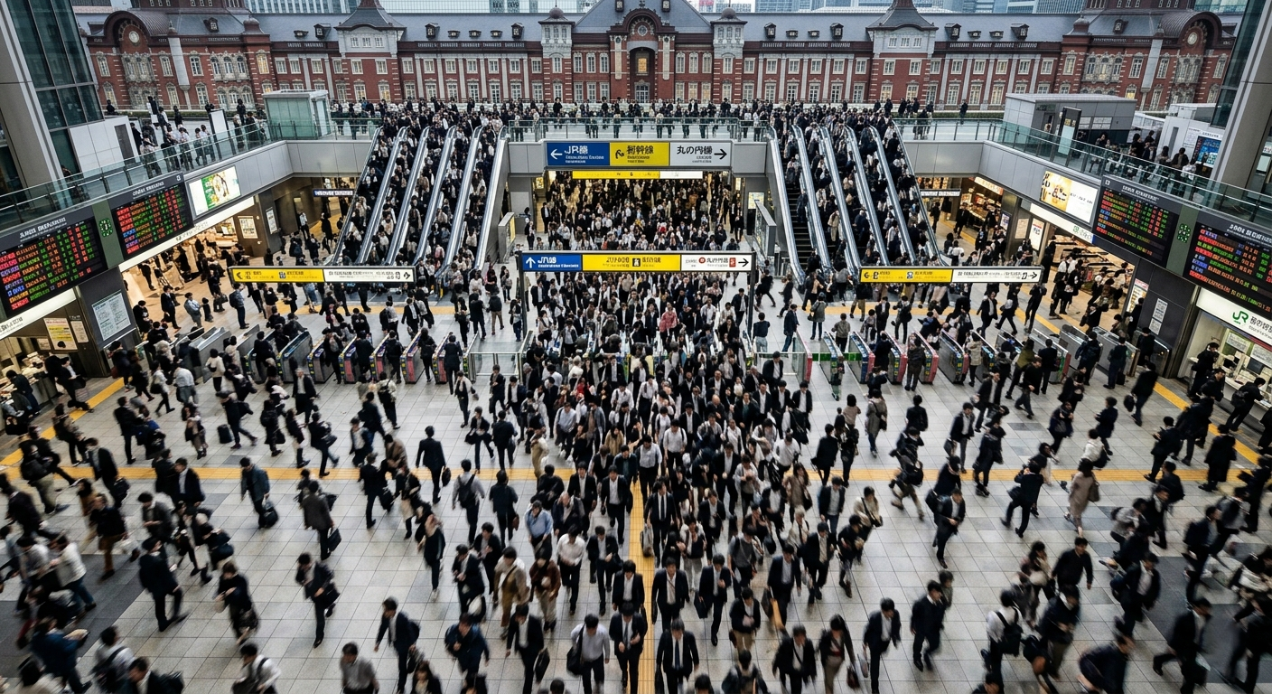

Slide 22
we infer, predict, what-if scenario and play with uncertainty all the time

Slide 23
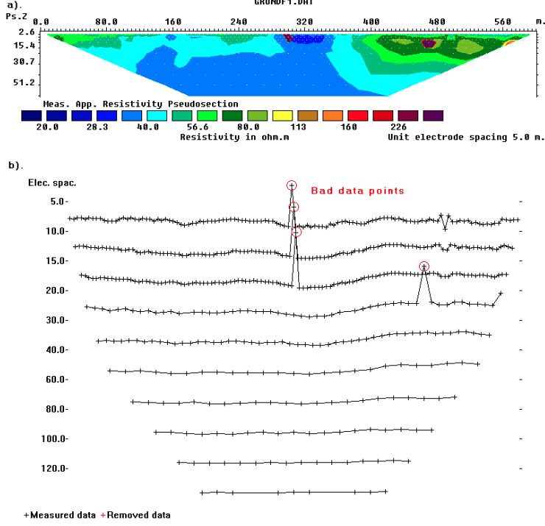
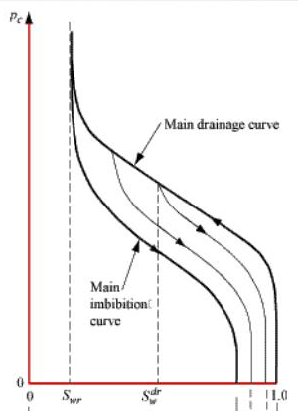
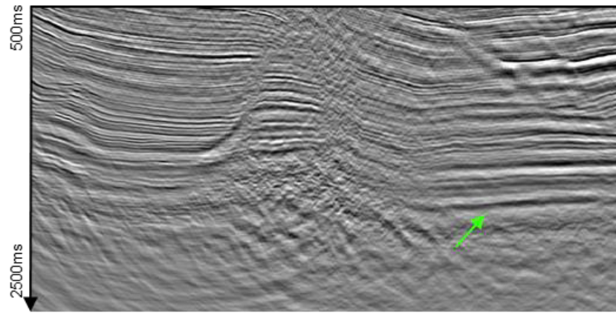
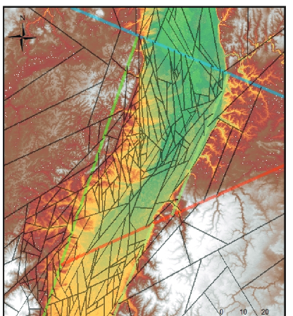
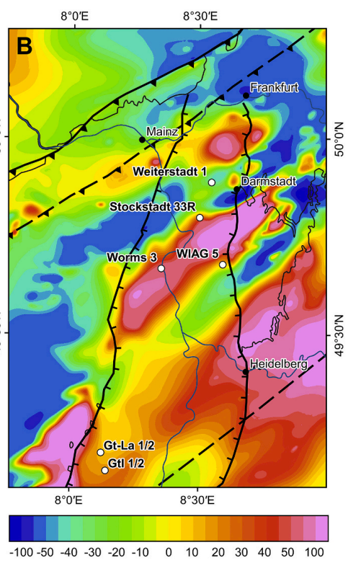
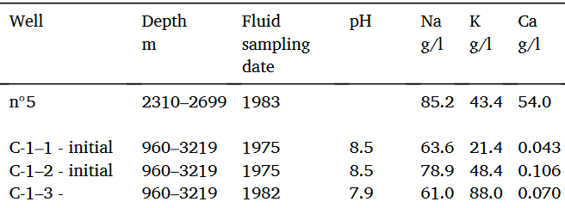
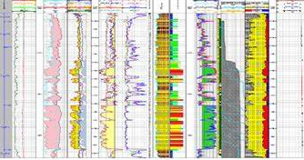

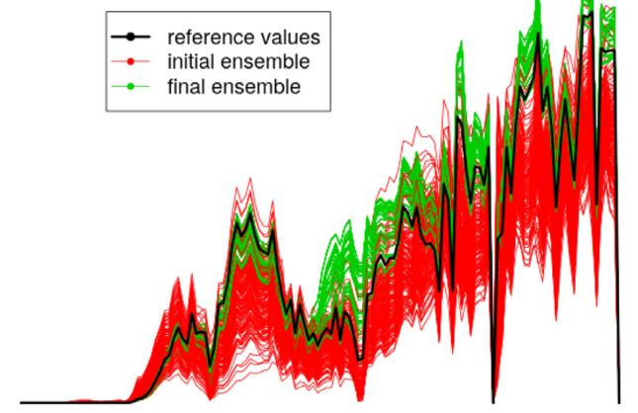
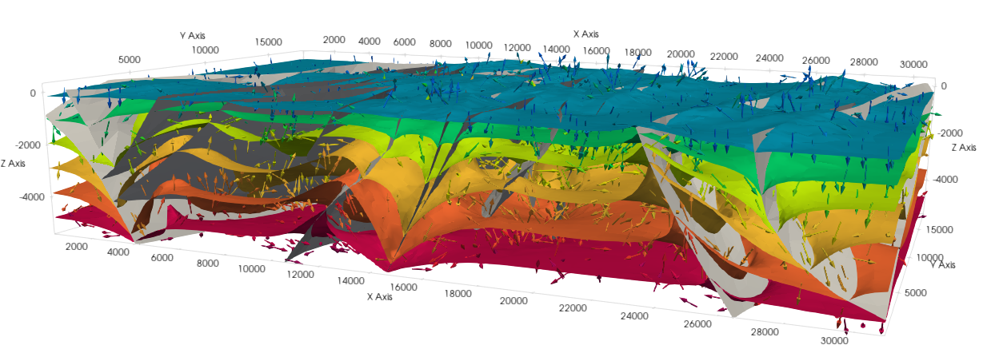
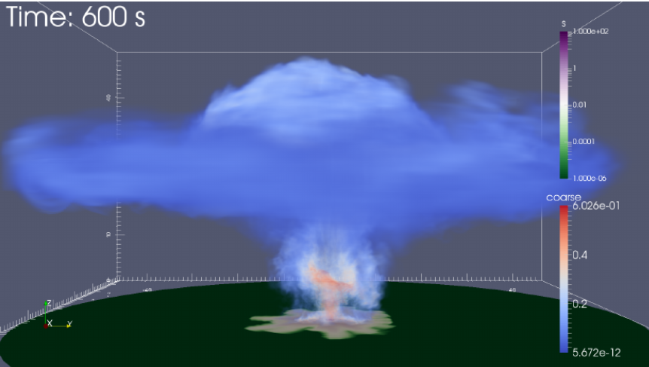
What is data assimilation intrinsically
Seismic
Faults network
Magnetic anomalies
Resistivity
Geochemistry
Petrophysics
Model(s)
Data Assimilation

Slide 24
What is data assimilation intrinsically
Seismic
Faults network
Magnetic anomalies
Resistivity
Geochemistry
Resistivity
Model(s)
Data Assimilation
Correct a model from data
Updated model(s)

Slide 25
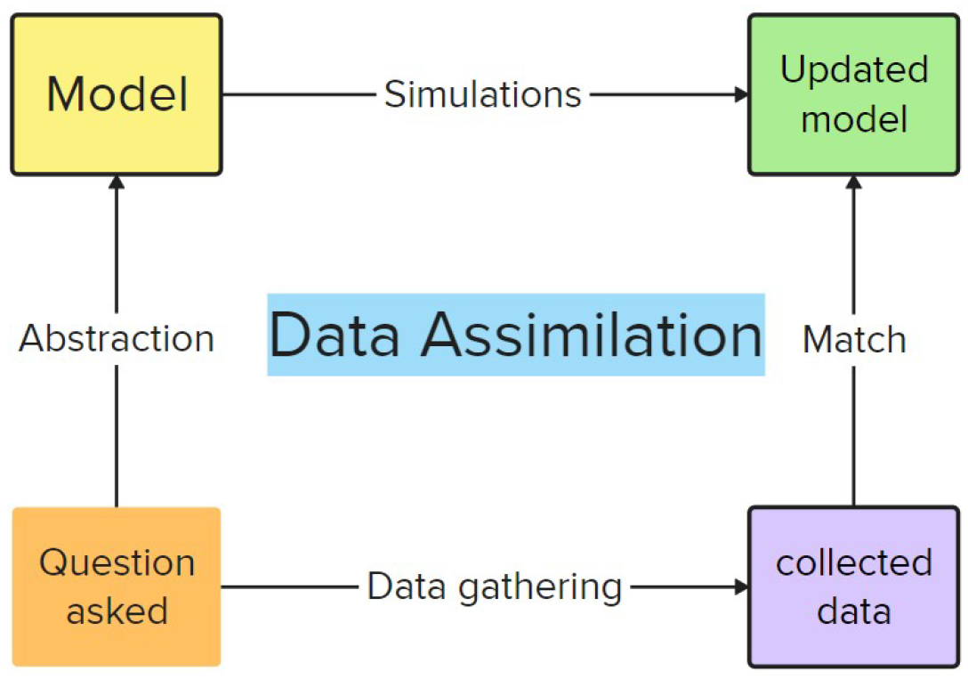
What is data assimilation intrinsically
Seismic
Faults network
Magnetic anomalies
Resistivity
Geochemistry
Resistivity
Model(s)
Data Assimilation
Correct a model from data
Updated model(s)

Slide 26
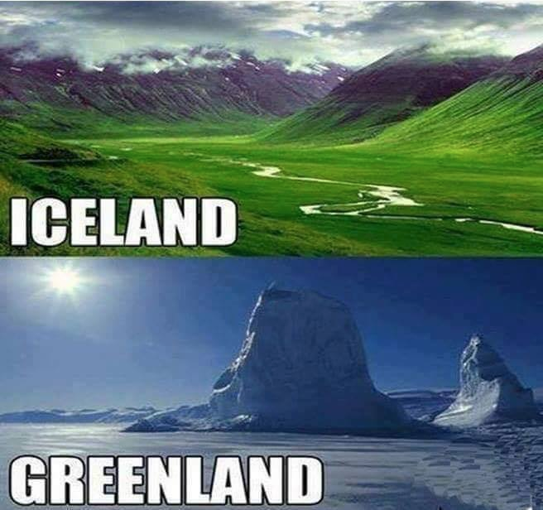
Words matter!!

Slide 27
What is data assimilation intrinsically
Data assimilation, model update, model calibration, history matching, optimization
What the fuss about?
Term | What is being adjusted? | When does it happen? | Which community?
Data Assimilation | Current State (Variables changing in time) | Real-time / Continuous | Meteorology, Geophysics, Climate, Oil & Gas
History Matching | Subsurface Parameters (Porosity, Permeability) | Offline (On past data) | Oil & Gas, Hydrology, CO2 storage
Model Calibration | Physical Constants (Friction, Elasticity) | Before deployment | Mechanical/Civil Eng., hydrogeology
Model Update | Structural Integrity / Matrix Geometry | Periodically (As things age) | Oil&Gas, Aerospace
Optimization | The mathematical algorithms used by all above | At any given time | Mathematics / Informatics

Slide 28
What is data assimilation intrinsically
Data assimilation, model update, model calibration, history matching, optimization
What the fuss about?
Usually, people mean
Data assimilation
Ensemble methods
EnKF - Ensemble Kalman filter
ES – Ensemble smoother, IES – iterative ES
ESMDA – Ensemble Smoother Multiple Data Assimilation

Slide 29
What is data assimilation intrinsically
Data assimilation, model update, model calibration, history matching, optimization
What the fuss about?
Usually, people mean
Data assimilation
Ensemble methods
EnKF - Ensemble Kalman filter
ES – Ensemble smoother, IES – iterative ES
ESMDA – Ensemble Smoother Multiple Data Assimilation
CMAES – Covariance Matrix Adaptation Evolutionary Strategy
DE - Differential Evolution
BO – Bayesian Optimisation

Slide 30
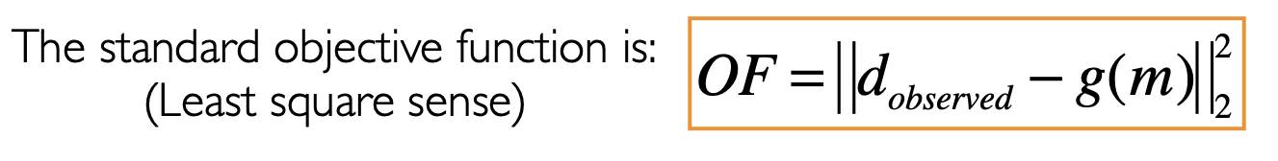
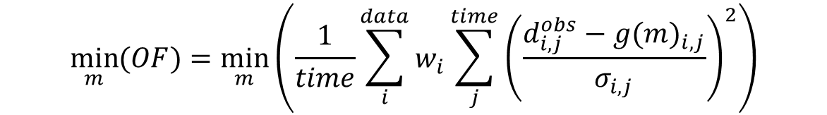
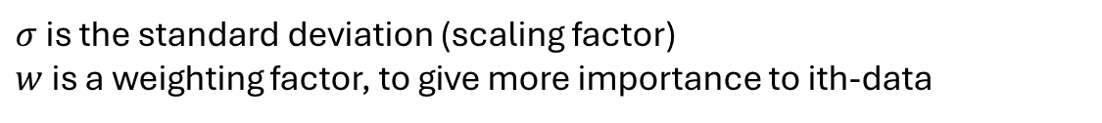
What is data assimilation intrinsically
Data assimilation, model update, model calibration, history matching, optimization
What the fuss about?
In the end we need to optimise the following Objective Function (hands on):
$$\min_{m}{(OF)}=\min_{m}\left(\frac{1}{time}\sum_{i}^{data}{w_{i}\sum_{j}^{time}{{\left(\frac{d_{i,j}^{obs}−g{(m)}_{i,j}}{σ_{i,j}}\right)}^{2}}}\right)$$
Alter the parameters m to minimise the error between the observed and modeled data over all the time steps and all kind of data to assimilate
$σ$ is the standard deviation (scaling factor)
$w$ is a weighting factor, to give more importance to ith-data

Slide 31
(Summary) Comparative table for assimilation approaches
Method | Handling of Non-Linearities | Computational Cost (Time) | Implementation Complexity | Time & Data Management | Evolution Context / Specificity
EnKF (Ensemble Kalman Filter) | Low to Medium. Handles mild non-linearities via ensemble sampling, but fails on abrupt, highly non-linear physics. | Low. Proceeds step-by-step sequentially. Does not recompute the past. | Medium. Requires coding the matrix measurement update step at every single time step. | Sequential. Analyzes data in real-time, continuous data stream. No historical memory. | Limitation: Unable to properly estimate static, fixed geophysical parameters over a whole time window without creating harsh physical discontinuities. Evolved toward ES.
ES (Ensemble Smoother) | Low. Performs only a single global correction step. If the physics is highly non-linear, ES fails (leads to ensemble collapse). | Very Low. A single forward run per member over the entire window, and a single matrix update. | Medium. Conceptually close to EnKF, but executed all at once on a giant block of data. | Global Window. Ideal for History Matching. Processes the entire past dataset in a single block. | Limitation: Completely blind to severe physical non-linearities due to its single-step resolution. Evolved toward IES / ES-MDA.
IES (Iterative Ensemble Smoother) | Medium to Good. Introduces iterations (typically Gauss-Newton type) to resolve non-linearities. | Moderate. Requires rerunning the entire ensemble of simulations at each iteration. | High. Requires coding ensemble-approximated gradients and specific convergence criteria. | Global Window. Ideal for the inversion of historical parameters. | Limitation: Gradient-based iterations are prone to getting trapped in local minima if the physics is highly non-linear or chaotic. Evolved toward ES-MDA.
ES-MDA (Ensemble Smoother with MDA) | Excellent. Attenuating data impact via inflated artificial measurement noise smooths severe non-linearities without collapsing the ensemble. | Moderate. Highly efficient: requires only a fixed $N$ iterations (typically 4 to 8) of the ensemble. | High. Advanced matrix algebra to code (SVD, noise inflation scheduling at each step). | Global Window. Current industrial standard for History Matching and complex geophysical inversion. | The Current Standard: The ultimate sweet spot between computational execution speed and robustness against severe physical non-linearities.
CMA-ES (Covariance Matrix Adaptation) | Maximum. Does not rely on any linearity or Gaussian distribution assumptions. Smoothly jumps over discontinuities. | Extremely High. A "Black-Box" evolutionary approach requiring thousands of forward model evaluations. | Very Low. Used out-of-the-box via ready-made libraries (cmaes in Python) without modifying the model's inner code. | Flexible. Can optimize on a single snapshot (3D) or over an entire time window (4D), depending on the defined cost function. | The Statistical Alternative: Deployed when the model is an absolute black box. It dynamically adapts a population genetics strategy via a covariance matrix to fast-track toward the global optimum.
DE (Differential Evolution) | Maximum & Ultra-Robust. Specifically engineered for non-convex, multimodal (riddled with false minima), and noisy search spaces. | Extremely High. A genetic algorithm requiring a massive number of generations (sometimes even more than CMA-ES). | Very Low. Highly popular and widely available in open-source tools (e.g., scipy.optimize.differential_evolution in Python). | Flexible. Same as CMA-ES; fits seamlessly with any mathematical cost function definition. | The Global Bulldozer: Where CMA-ES relies on probabilistic concepts (covariance matrix), DE uses difference vectors between individuals to mutate. It is often slower than CMA-ES, but even more resilient against getting trapped in complex local minima.
BO (Bayesian Optimization) | Maximum. Handles highly non-linear, multi-modal, and noisy black-box cost functions effortlessly by modeling them probabilistically. | Extremely Low on Model Runs, but High on Internal Math. Designed specifically for scenarios where running the physical model is incredibly expensive. | Very Low. Easily implemented via robust libraries (e.g., scikit-optimize, BoTorch, or GPyOpt). | Flexible. Governed strictly by the definition of the cost function over an instant or a time window. | The Smart Choice for Heavy Models: While CMA-ES and DE blindly run thousands of simulations, BO builds a surrogate model (Surrogate/Gaussian Process) to intelligently pick the next best parameter to test. It achieves global convergence with minimal model evaluations, making it ideal if your digital twin takes hours to run a single simulation.

Slide 32
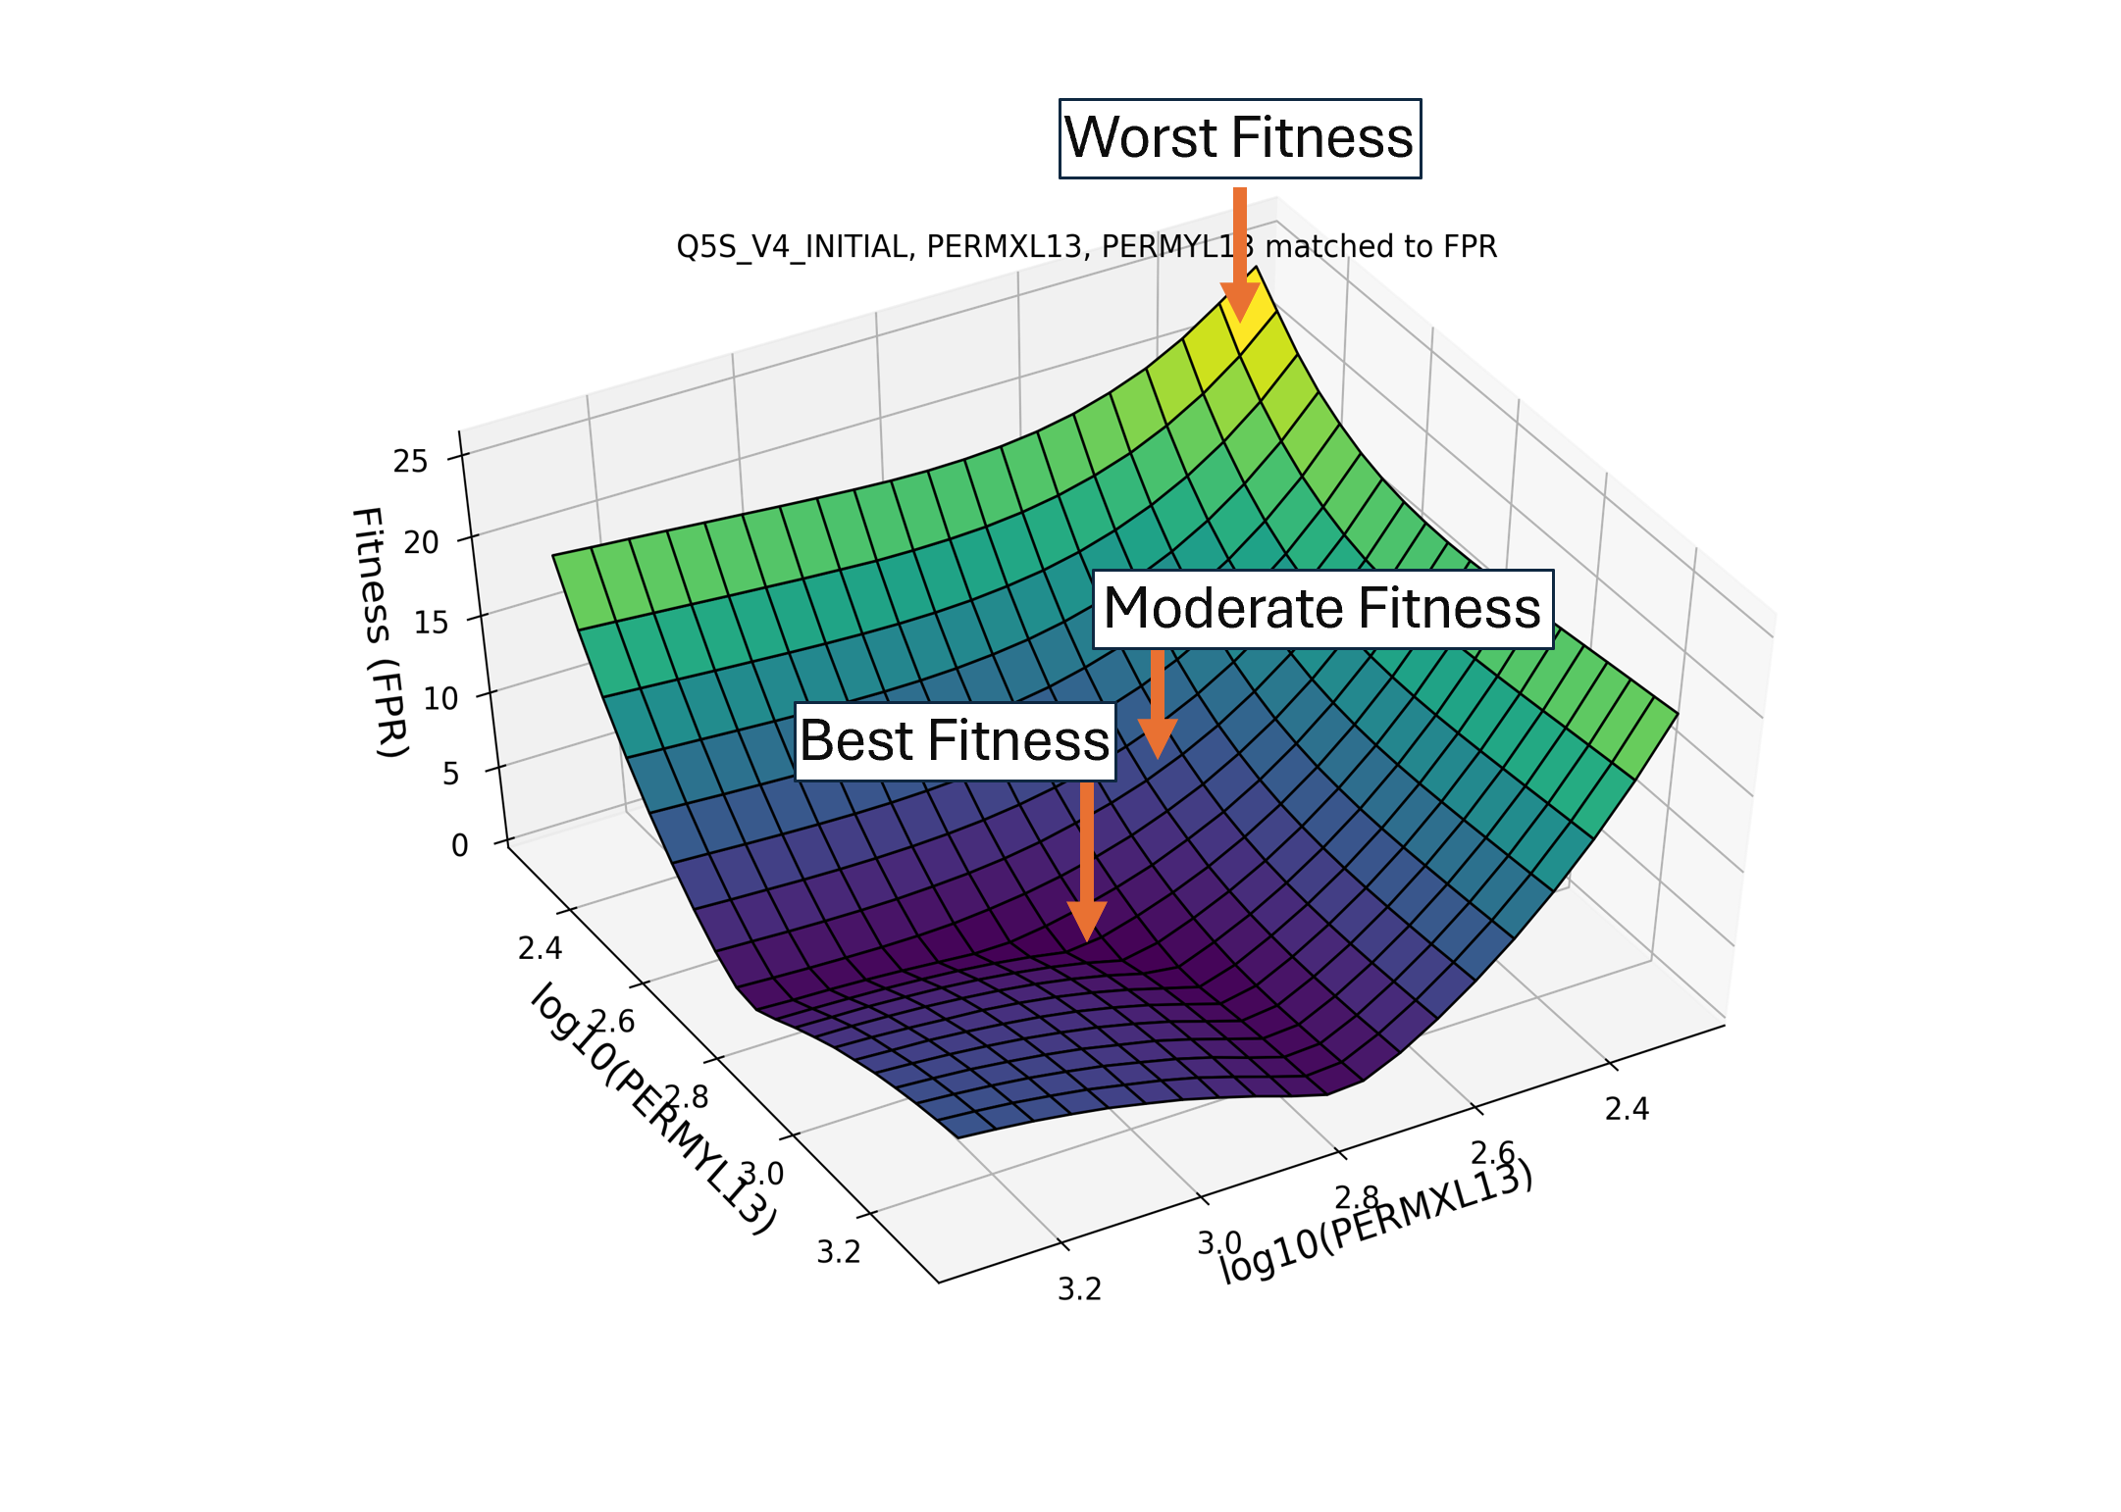
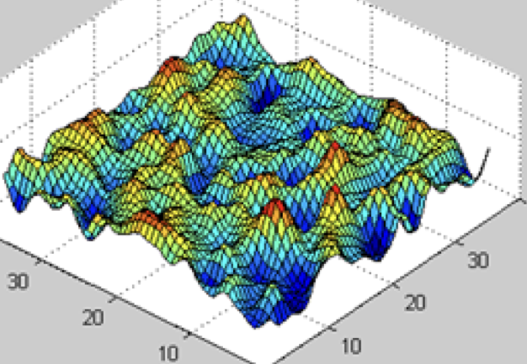
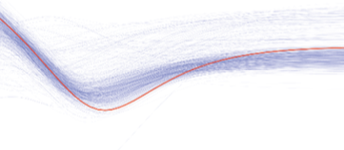
(Summary) Comparative table for assimilation approaches
Method | Easy to implement | High Problem dimension (parameters) | Long simulation runtime | Only Black-box | Main REASON
ES-MDA (Ensemble Smoother with MDA) | Not ideal | YES | OK | Not ideal | Uncertainty Quantification
CMA-ES (Covariance Matrix Adaptation) | YES | Not ideal | Not ideal | YES | Highly non-linear problems (multimodality), tendency to converge too quickly -> DE
DE (Differential Evolution) | YES | Not ideal | Not ideal | YES | Highly non-linear problems (multimodality), Exploration>Exploitation
BO (Bayesian Optimization) | OK | Not ideal | YES | YES | If the simulation is heavy, use BO (not too large search space)

Slide 33
(Summary) Comparative table for assimilation approaches
no free lunch theorem, there is no best method or algorithms so far to solve our subsurface problems, depends of the class of the problem you are trying to solve.
David Wolpert and William Macready (1997).

Slide 34
Data assimilation, an example
Data assimilation, a brief history
What Data Assimilation stands for?
The main Challenges in Data Assimilation
Multiphysics, Multisource, Multiscale, Multidiscipline, Uncertainty

Slide 35
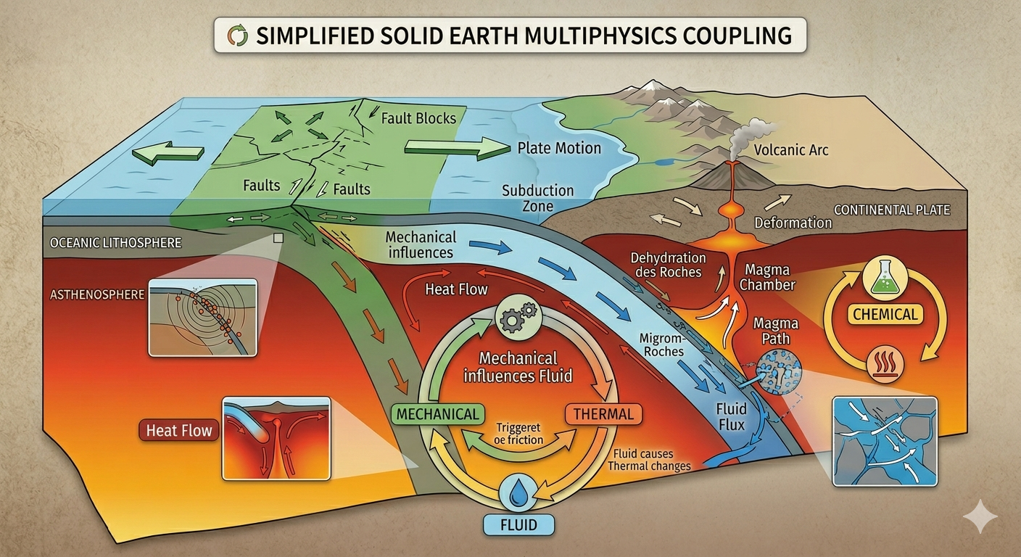
A Multiphysics problem
Definition: Multiphysics is the study of systems that involve more than one simultaneous physical field. In the real world, physics does not happen in isolation.
The Traditional Approach: Usually, we study "Silos":
  Thermodynamics (Heat)
  Chemistry (Reaction)
  Structural Mechanics (Stress/Strain)
  Fluid Dynamics (Air/Water flow)
  Electromagnetics (Electricity/Magnetism)
The Multiphysics Approach: It explores the Coupling (interaction) between these silos. If you heat a metal bar (Thermo), it expands (Structural). That expansion is a multiphysics interaction.
Remark: Rather often we do one-way coupling, just because it is too complex and computationally costly to setup a strong coupling,

Slide 36
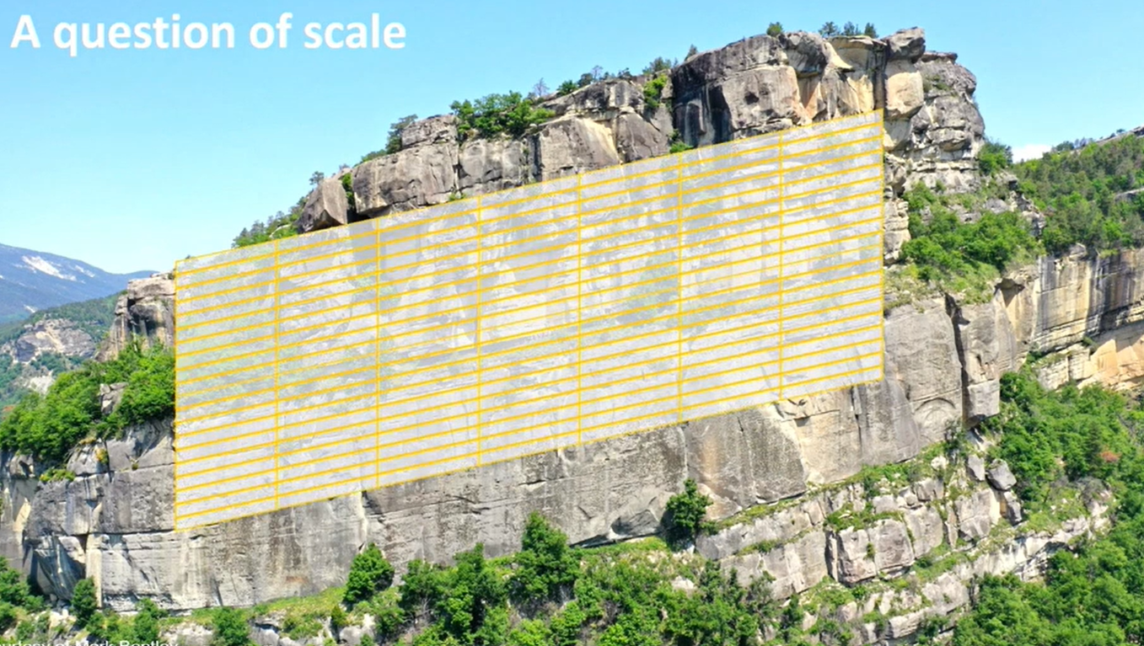
A Multiscale problem
Extracted from Geiger
200m

Slide 37
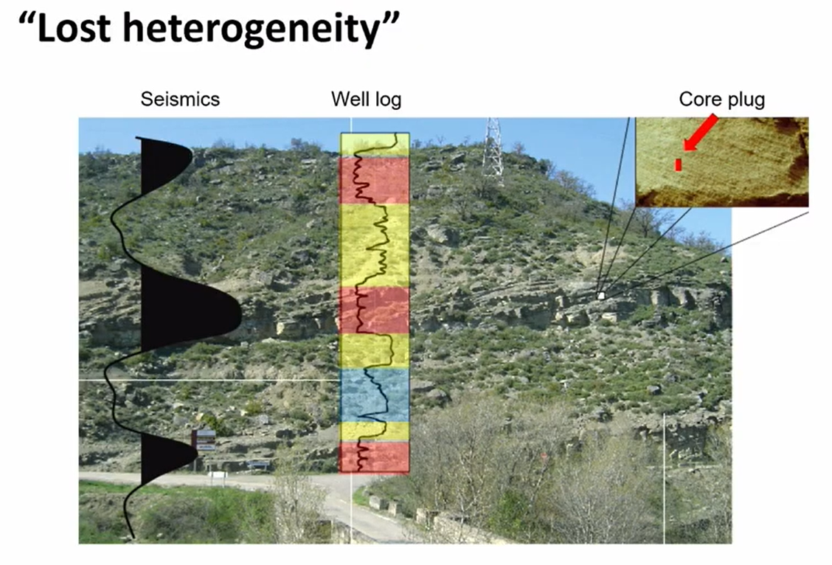
A Multiscale problem
Extracted from Geiger

Slide 38
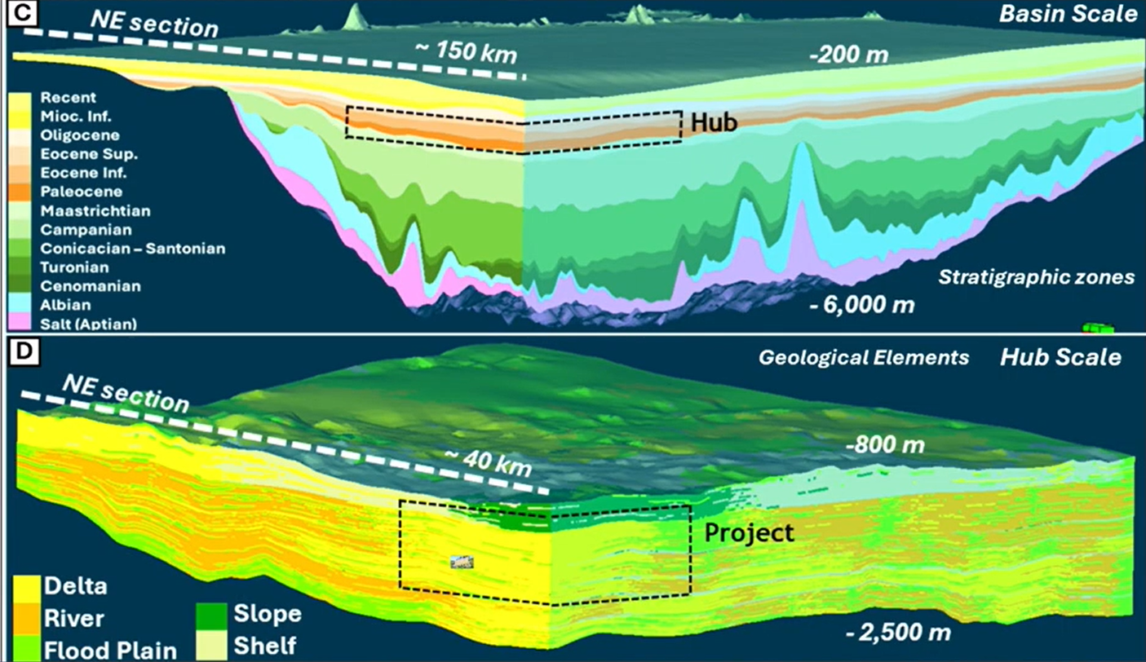

A Multiscale problem
Extracted from Geiger

Slide 39
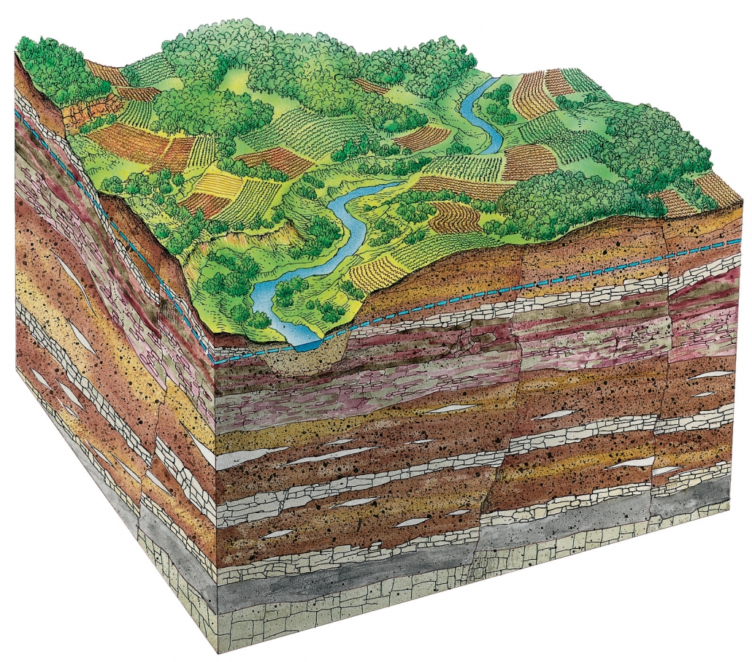
Multisources
Image based information (e.g., 2D seismic, electromagnetic)
+
+
+
Wells

Slide 40

Uncertainty
Definition: Uncertainty is a tentative of quantification of our ignorance
(rephrased from The art of Uncertainty, David Spiegelhalter)

Slide 41
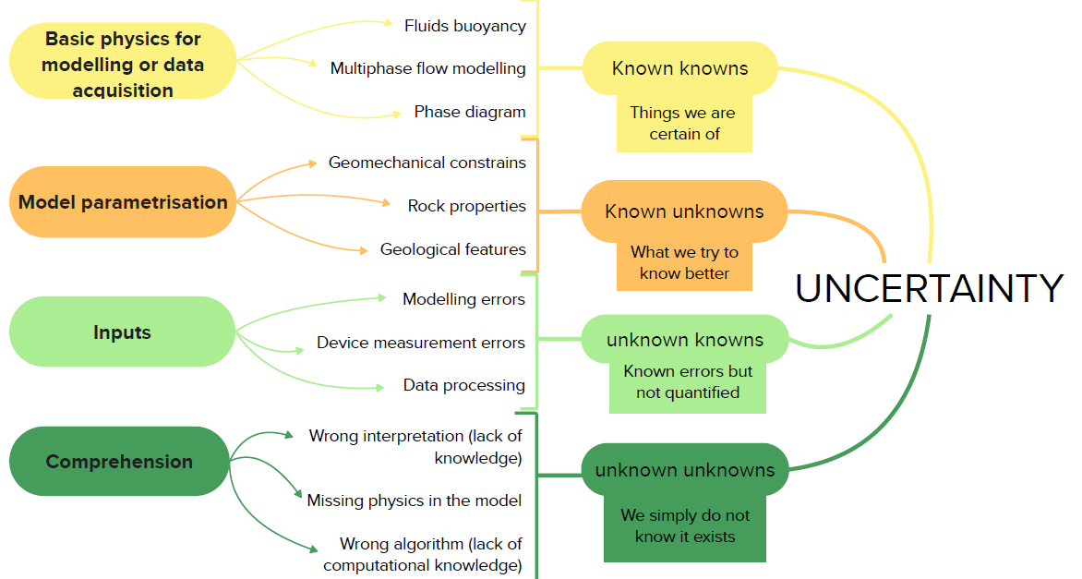

Uncertainty

Slide 42
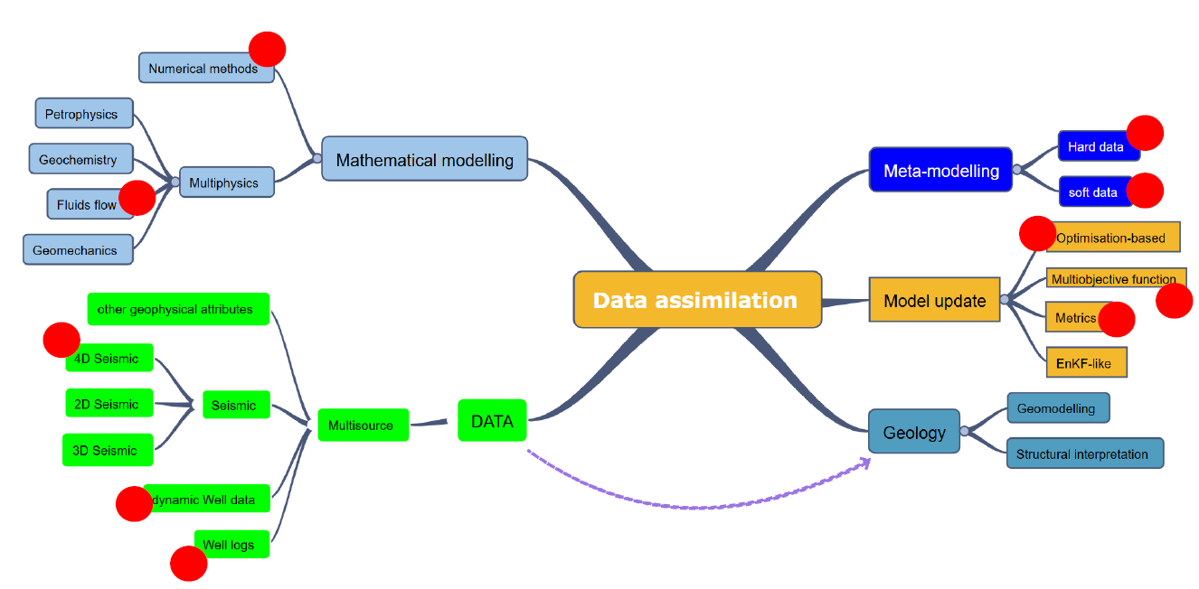
Multidisciplinary

Slide 43
Data assimilation, an example
Data assimilation, a brief history
What Data Assimilation stands for?
The main challenges in Data Assimilation
Time to wrap up

Slide 44
Critical remaining challenges
The current frameworks lack a comprehensive assessment of uncertainty characterization, quantification, and propagation across the entire chain of events: How to merge different data (different uncertainty) and reconcile different scales?
Coupling multiphysics remains challenging and depends heavily on scale-dependent Reduced-Order Modeling (ROM). Operationally, localized models (10km) demand high fidelity modelling, whereas large-scale simulations can rely on low fidelity modelling to remain computationally feasible.
Bridging the communities. Data assimilation, model calibration, Optimisation .. / hydrogeology, climate sciences, georesources, mechanical engineering, etc.. Do the same thing (have the same needs), but they don’t talk to each other..
1. Should be accessible to the communitieS: Open Science Data Assimilation benchmarking frameworks & libraries should be out there. Including all the main DA family algorithms, metrics, objective functions, main metamodeling methods, Verification,Validation and UQ methods, data cleaning, .. USE CASES.
2. Digital twins will make obvious the point 1.

Slide 45
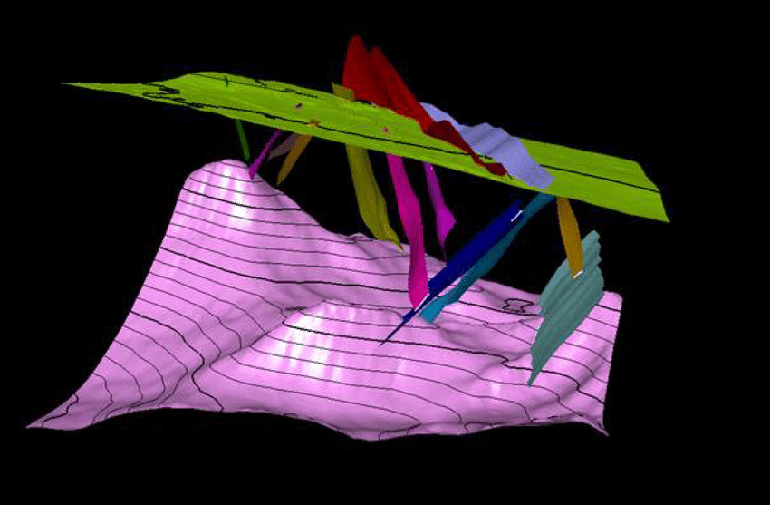
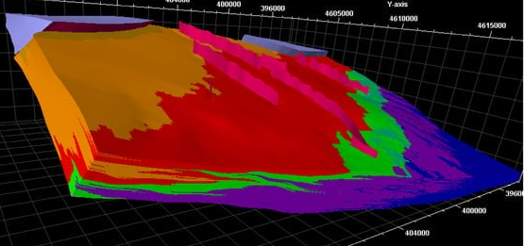
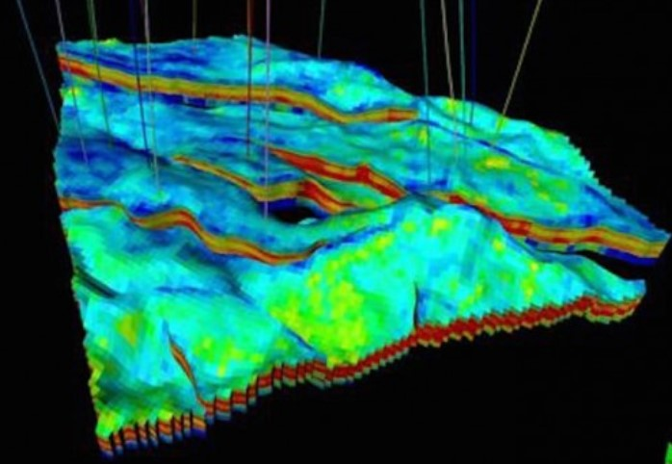
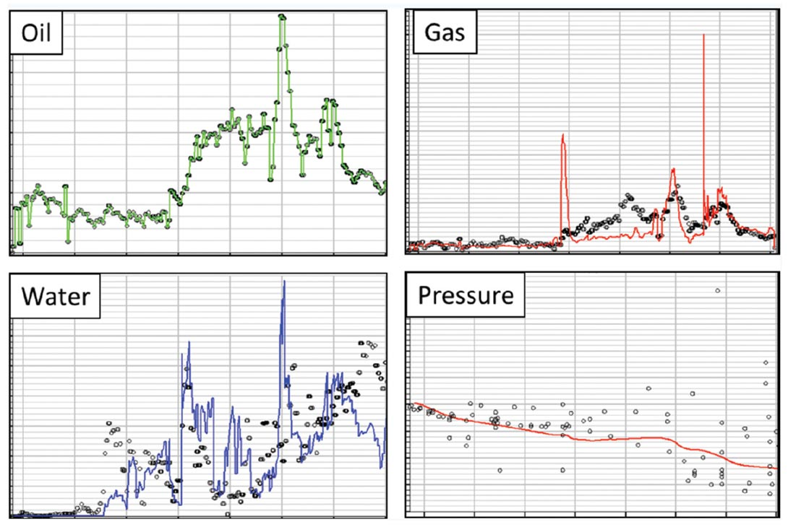
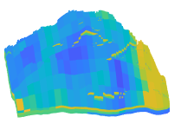
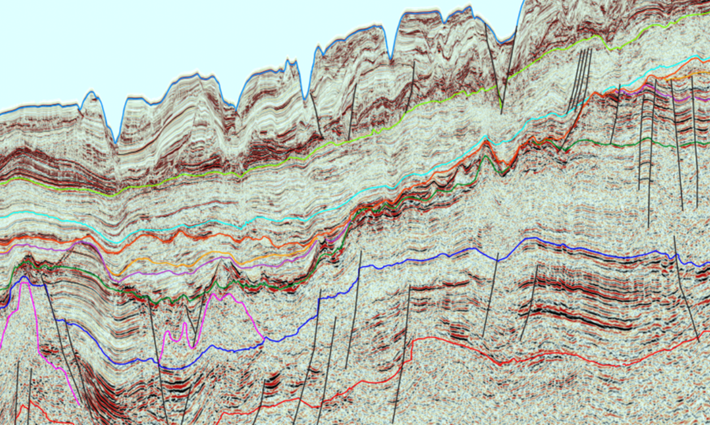
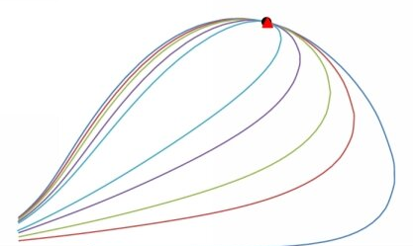
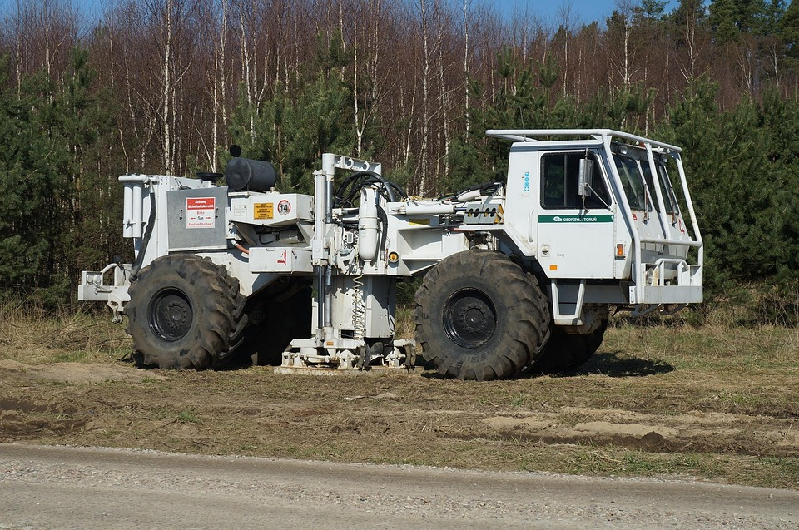
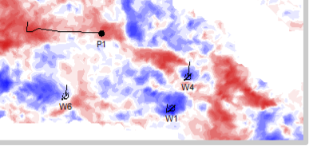
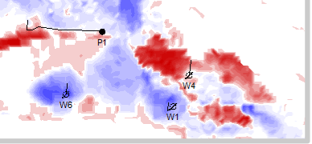
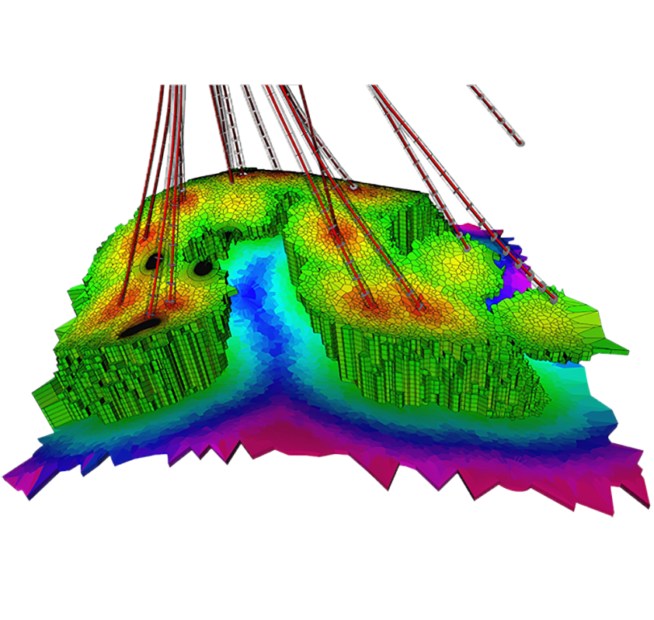
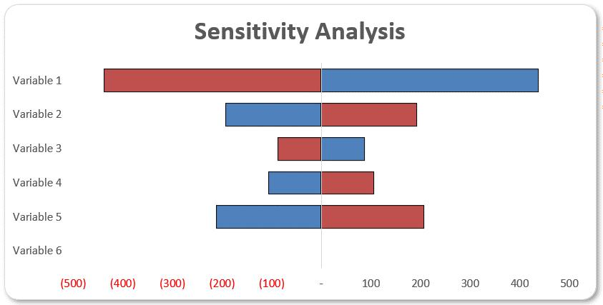

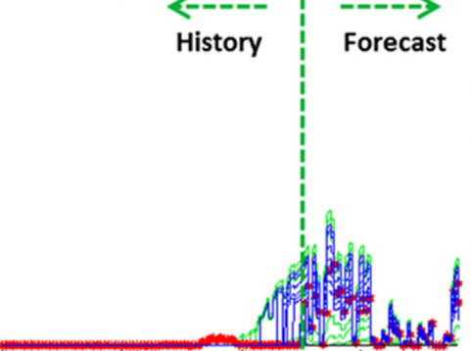
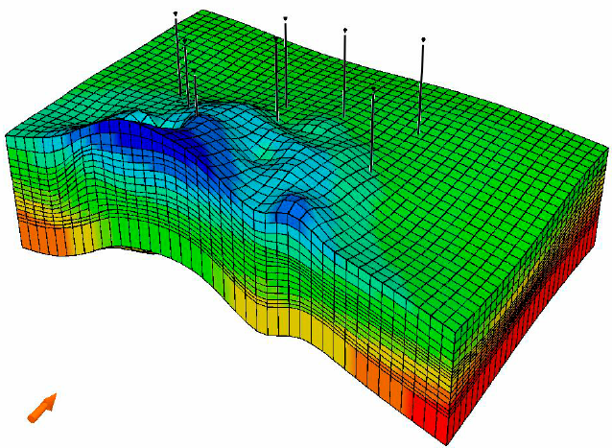
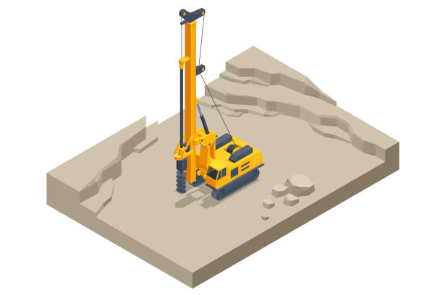
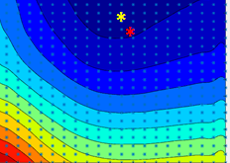


Time to wrap up
Numerical world
Real world
Structural modelling
Rock-fluid
properties
Fluid
properties
Production data
Data acquisition and processing
(4D)Seismic interpretation
Domain
transfer
Sensitivity analysis
Data assimilation
Simulation (dynamic) model
Forecasting
Metamodelling
Decision
Objective function
Assimilation approach
Metrics

Slide 46
Data Assimilation is about:
DA is for: forecasting, prediction and what-if scenario. It is to assist understanding of physical processes and assist a decision making.
  Data reduction, Raw data - > Smart Data (data vs information)
  Data assimilation, model calibration, optimisation
  Multiphysics modelling (complex systems)
  Advanced computing: HPC, quantum
  Verification, Validation and Uncertainty Quantification
  Metamodelling (ROM)

Slide 47
If we extend Data Assimilation:
DA is for: forecasting, prediction and what-if scenario. It is to assist understanding of physical processes and assist a decision making.
  Data reduction, Raw data - > Smart Data (data vs information)
  Data assimilation, model calibration, optimisation
  Multiphysics modelling (complex systems)
  Advanced computing: HPC, quantum
  Verification, Validation and Uncertainty Quantification
  Metamodelling (ROM)
  Value of information, active learning
  Decision making
  Agentic AI, Gen AI
  Optimal control
  Integration environment, orchestration multisoftware
  Data and computational Infrastructure
  FAIR data
  Cybersecurity
  Code architecture (maintenance and obsolescence) ?
  Social Dashboarding (3-level, policy makers, scientific experts, general public)

Slide 48

Beyond Data Assimilation: DIGITAL TWINS

Slide 49

DIGITAL TWINS
This is another story ..

